Slide 1
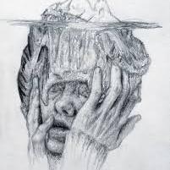
Fake papers, paper mills and peer review
Gerben ter Riet, MD PhD
for the EBM Masters 19 June 2024
https://orcid.org/0000-0002-2231-7637
Big thank you to Lex Bouter and
Mario Malicki for sharing slides
Slides are at https://www.researchequals.com/
Notes:
Long version by Lex Bouter: https://www.youtube.com/watch?v=64UTTIJr6wk

Slide 2
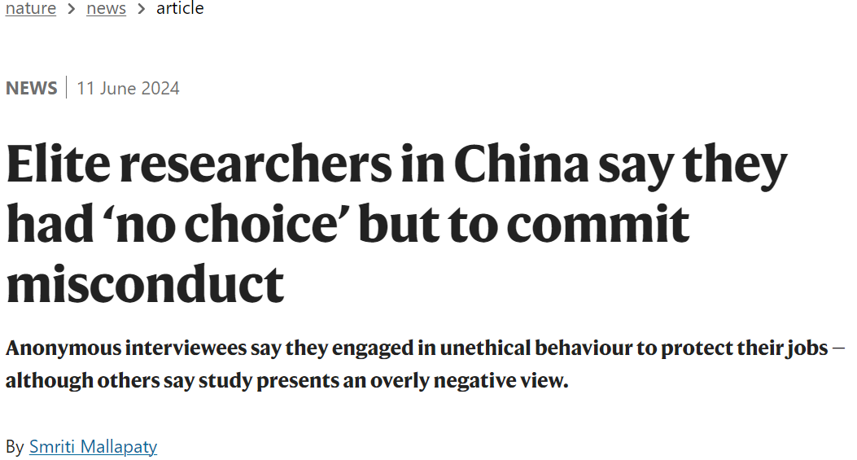
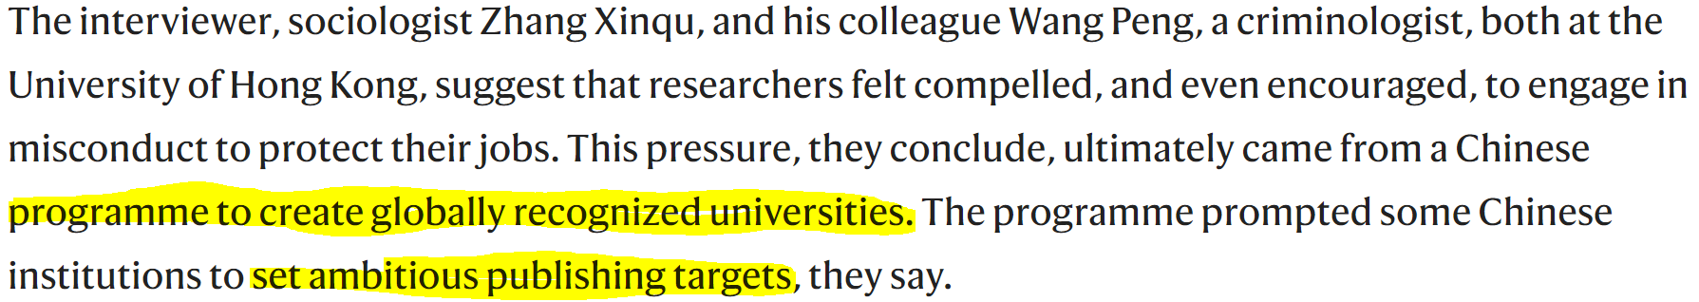
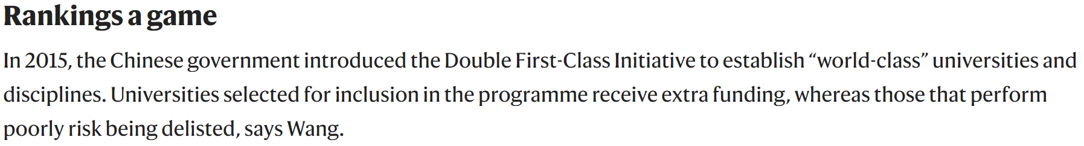
Notes:
Elite researchers in China say they had ‘no choice’ but to commit misconduct (nature.com)
https://en.wikipedia.org/wiki/Sokal_affair

Slide 3
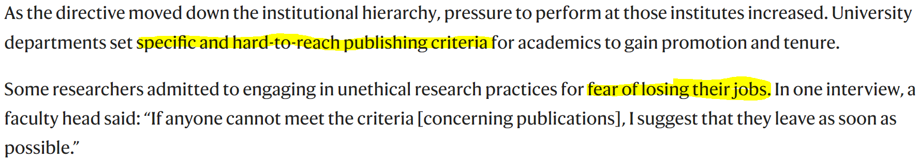
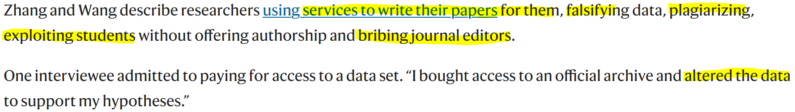

Slide 4
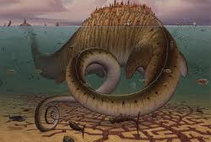
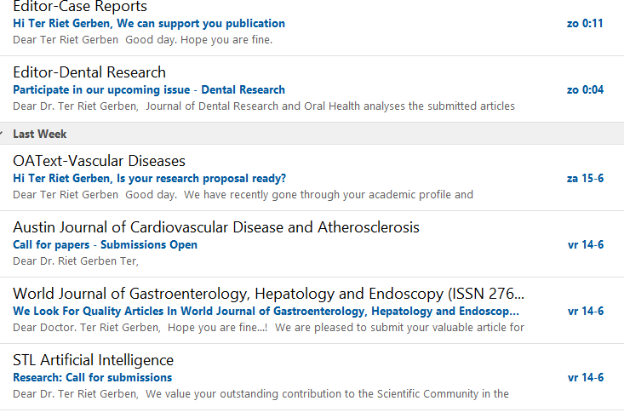
My mailbox on an average day

Slide 5

The publish-or-perish culture
lack of awareness of predatory publishing and
difficulty in discerning legitimate from illegitimate publications
Push for open access (Plan S)
.. foster an environment for predatory publications to exist.
Predatory journals are quick to adapt to policies and measures designed to foil them.
Notes:
The devil plays with the best laid plan

Slide 6
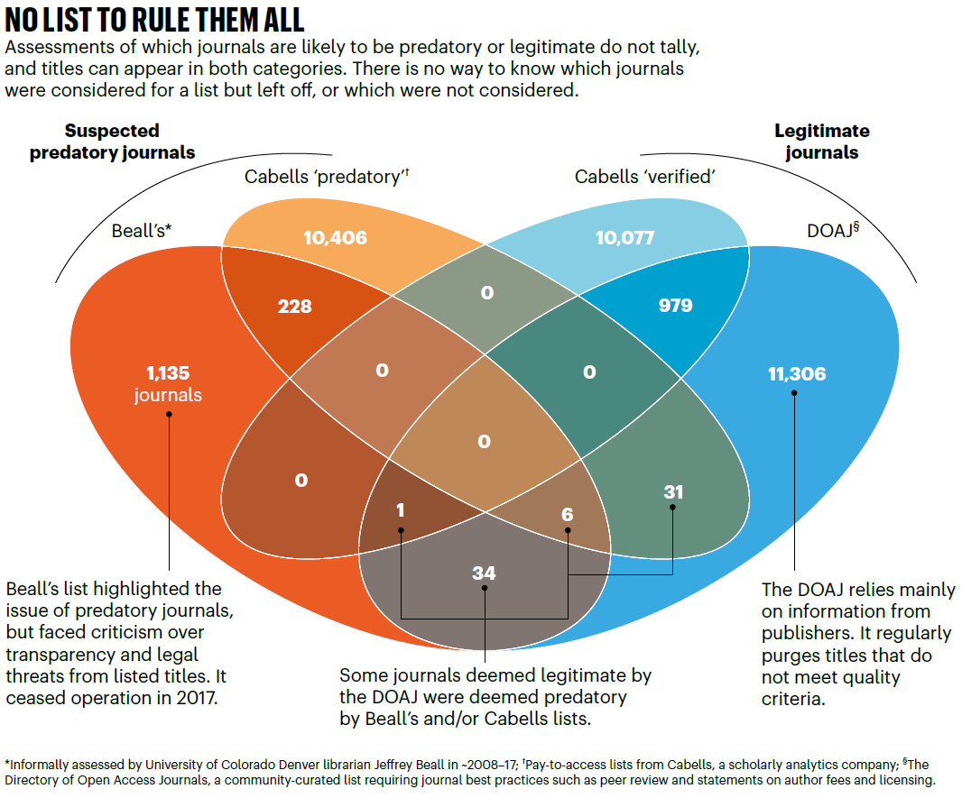
Notes:
Predatory journals: no definition, no defence (nature.com)
https://www.doaj.org/
https://learn.cabells.com/external/manual/journalytics-medicine-predatory-reports/article/what-is-journalytics?p=45bf0b37eb068f380076713fd7aa06de7e335634802a4a81e8a69b37b1c9d024
https://beallslist.net/
Only 8 to 9% (980/10077, 980/12457) overlap between Cabells verified/legit and DOAJ/legit!
Guest Post - Making Sense of Retractions and Tackling Research Misconduct - The Scholarly Kitchen (sspnet.org)
STM Integrity Hub - STM (stm-assoc.org)
PubPeer - Search publications and join the conversation.

Slide 7
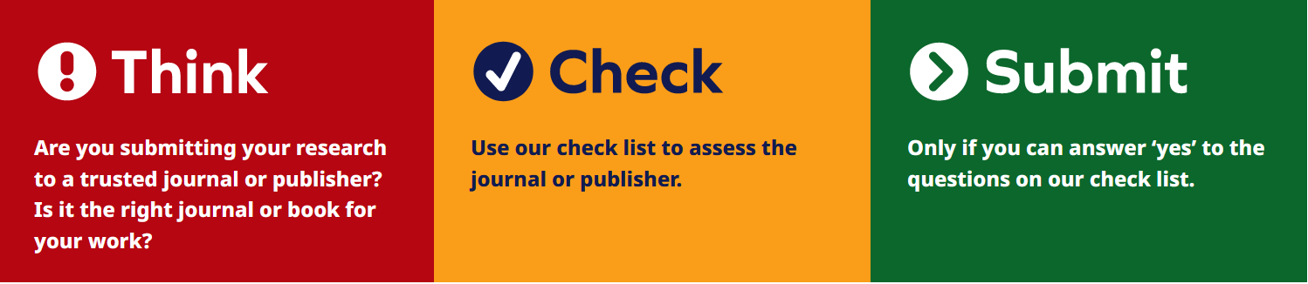
Notes:
https://wame.org/principles-of-transparency-and-best-practice-in-scholarly-publishing
https://thinkchecksubmit.org/

Slide 8
Problems with Peer Review
Inability to detect:
FFP, or questionable research practices
(significant) methodological deficiencies of papers
spin in results interpretation and generalizability
incorrect use of references
lack of reporting of items needed to reanalyse or replicate studies
And on top of that:
Inter-rater agreement is poor, absolute agreement 51%
Scepticism toward innovative research
Gender and country bias
Causes delays between study submission and publication
No CERTIFIED TRAINING PROGRAMS
No consensus on who is a PEER
Some authors do revisions out of fear of rejection, even if nonsensical
Notes:
What is peer review - EASE : EASE
https://steamtraen.blogspot.com/search?q=fawzy

Slide 9
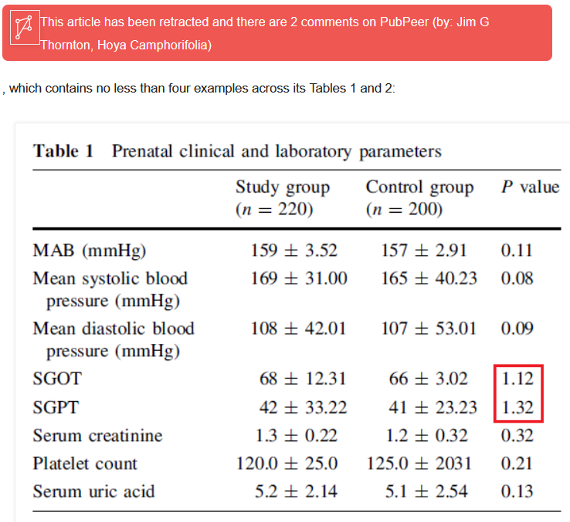
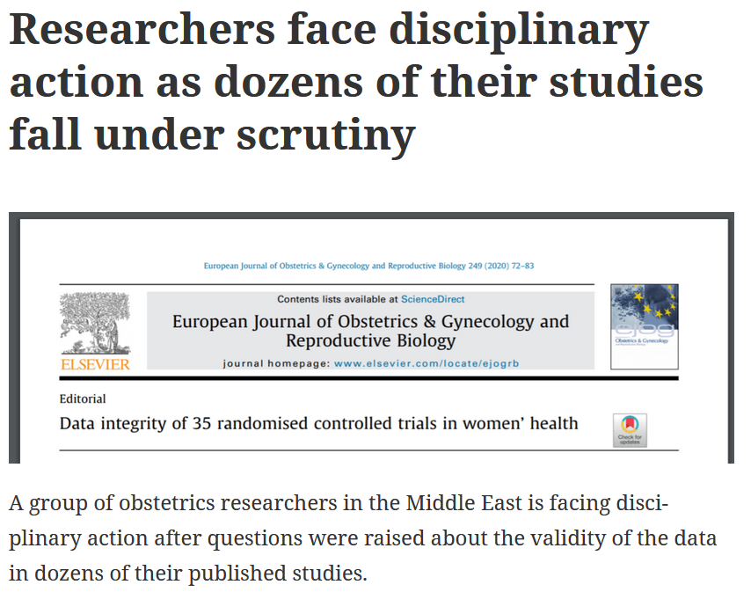
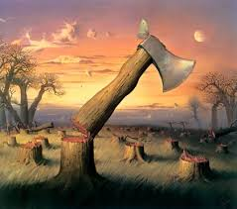
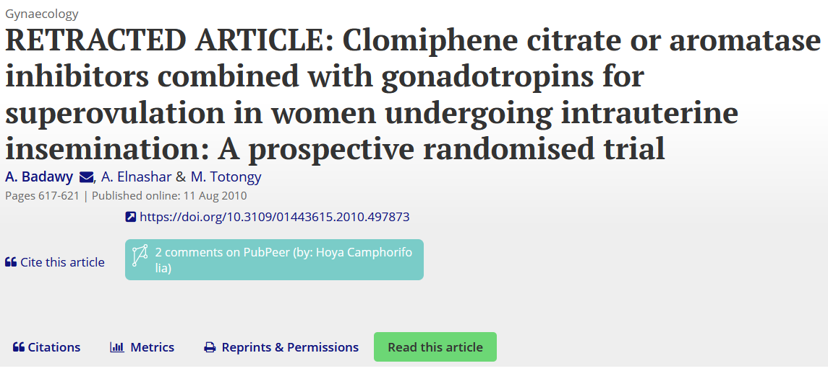
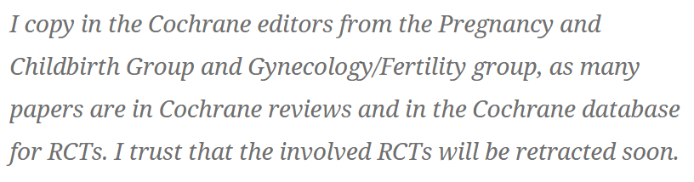
Notes:
Fake papers end up in reviews that may affect clinical patient guidelines
https://steamtraen.blogspot.com/search?q=fawzy
https://retractionwatch.com/2020/10/12/researchers-face-disciplinary-action-as-dozens-of-their-studies-fall-under-scrutiny/
https://retractionwatch.com/2021/08/10/critics-face-legal-threats-as-journal-takes-more-than-three-years-to-act/

Slide 10
Questionable practices “caused” by peer review
Fake peer reviews – ppl reviewing their own papers
Reviewers or Editors forcing authors to cite their own papers
Journals organizing to cite each other to boost their impact
Editors boosting their journals by citing the Journal’s papers in their own papers
Delaying or rejecting publications to steal ideas or publish first
Offensive comments

Slide 11
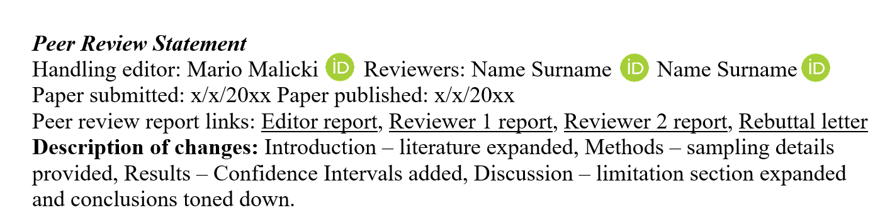
Steps towards the Future
Publish submitted manuscripts / preprints
Switch to Open Peer Review
Journals/Publisher should share review reports / metadata with researchers
Journals should switch to structured peer review
Notes:
Let us not be ashamed of what we don’t know, and what reviewers were kind enough to help us with. By sharing this information we will be able to better design educational interventions, and improve science. Please don’t hold your knowledge to yourselves, this pandemic and climate changes are maybe alerting us that we might not have as much time – lets use it best. Do we really need to wait for a top down approach to force open access or open peer review on us.

Slide 12
Structured peer review
Introduction
1. Is the background and literature section up to date and appropriate for the topic?
2. Are the primary (and secondary) objectives clearly stated at the end of the introduction?
Methods
3. Are the study methods (including theory/applicability/modeling) reported in sufficient detail to allow for their replicability or reproducibility?
4. Are statistical analyses, controls, sampling mechanism, and statistical reporting (e.g., P-values, CIs, effect sizes) appropriate and well described?
Results
5. Is the results presentation, including the number of tables and figures, appropriate to best present the study findings?
6. Are additional sub-analyses or statistical measures needed (e.g., reporting of CIs, effect sizes, sensitivity analyses)?
Discussion
7. Is the interpretation of results and study conclusions supported by the data and the study design?
8. Have the authors clearly emphasized the limitations of their study/theory/methods/argument?
Notes:
https://www.elsevier.com/reviewer/how-to-review/structured-peer-review
https://www.biorxiv.org/content/10.1101/2024.02.01.578440v1
https://scholar.google.nl/scholar?q=kilicoglu+ter+riet&hl=en&as_sdt=0&as_vis=1&oi=scholart

Slide 13

Download slides from https://www.researchequals.com/
Notes:
https://www.ncbi.nlm.nih.gov/pmc/articles/PMC10666927/pdf/elife-89736.pdf
https://www.nature.com/articles/d41586-020-02847-8

Slide 14
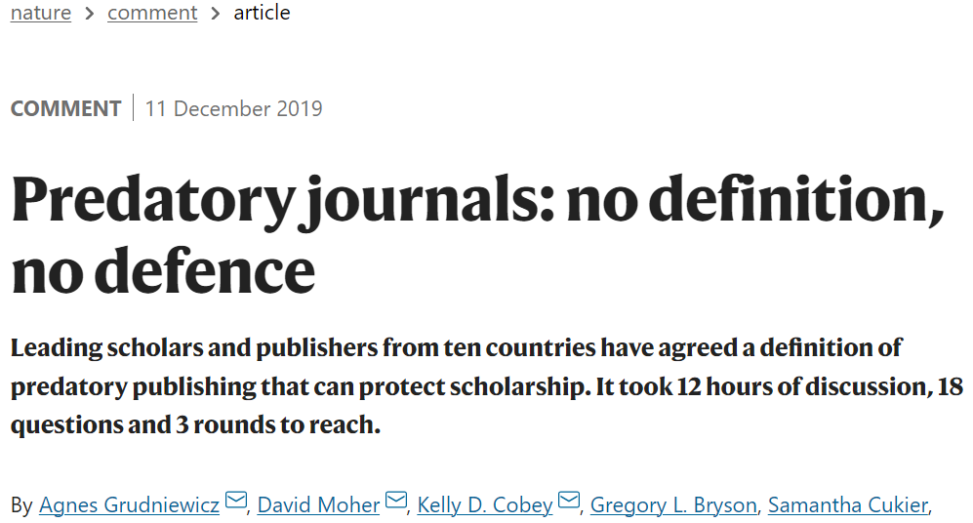

Slide 15
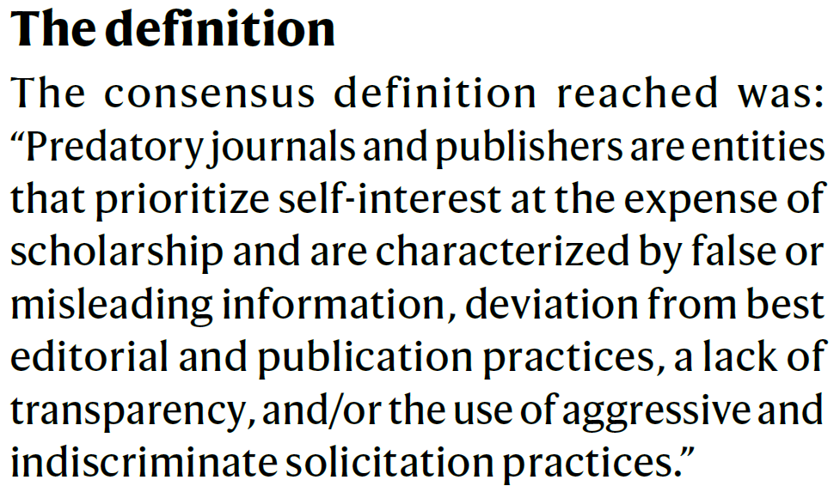
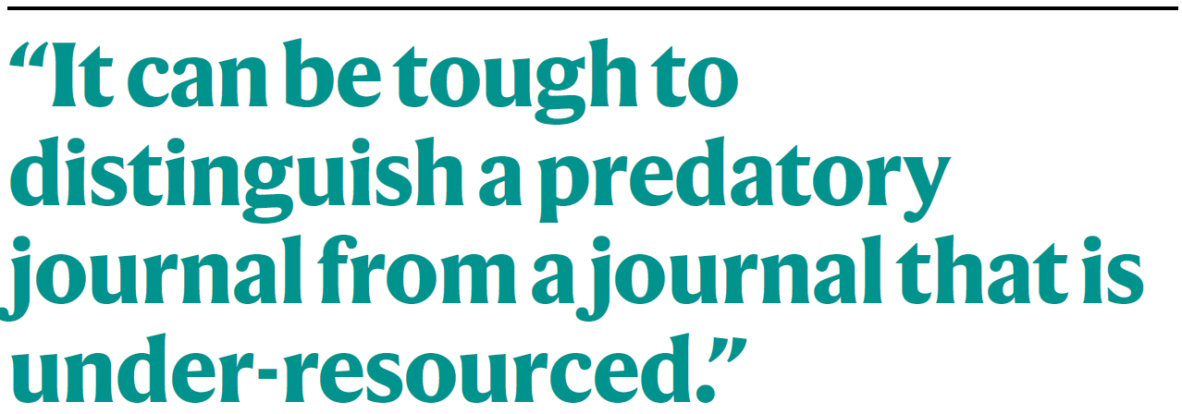
Notes:
https://thinkchecksubmit.org/
TERMS: ‘dark’, ‘deceptive’, ‘illegitimate’ and ‘acting in bad faith’.
False or misleading information. This applies to how the publisher presents itself. A predatory journal’s website or e-mails often present contradictory statements, fake impact factors,
incorrect addresses, misrepresentations of the editorial board, false claims of indexing or membership of associations and misleading claims about the rigour of peer review.

Slide 16
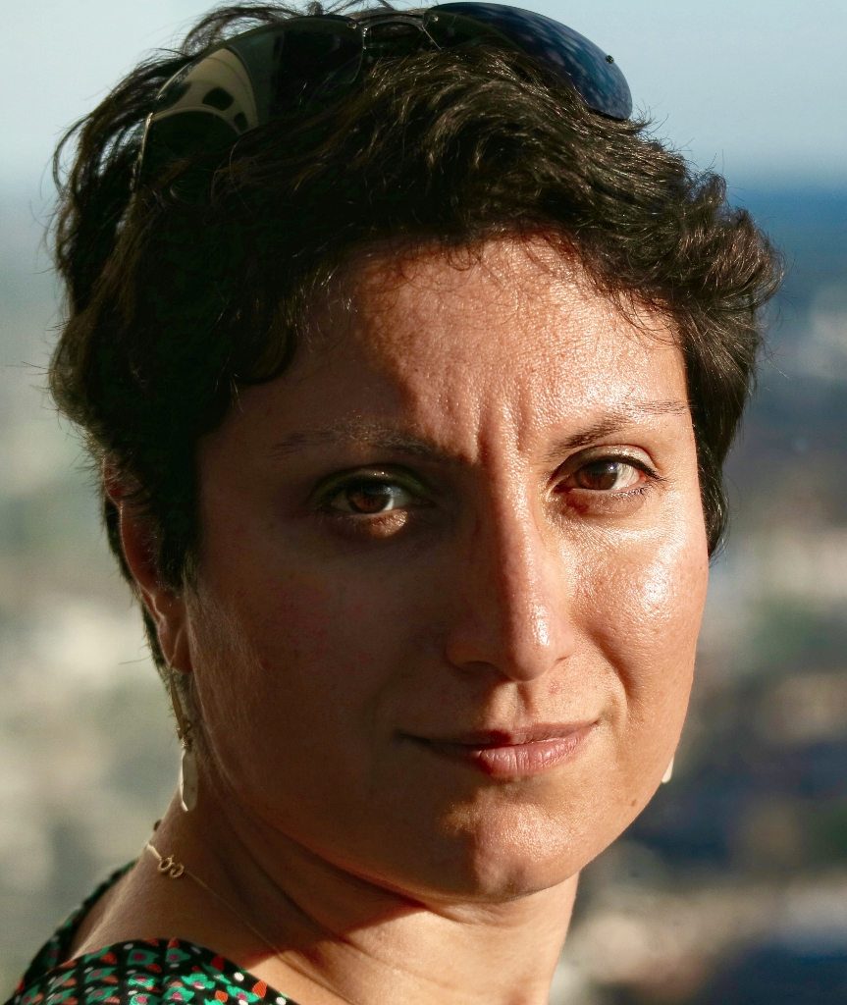
Peer Review Workbench
New dataset offering researchers unique insights into journal peer review process
https://www.elsevier.com/icsr/icsrlab/how to apply
Chaired by Dr. Bahar Mehmani

